Slide 1
Smart water fountains

Slide 2
Problem statement :
The project aims to enhance public water fountains by implementing IoT sensors to control water flow and detect malfunctions. The primary objective is to provide real-time information about water fountain status to residents through a public platform. This project includes defining objectives, designing the IoT sensor system, developing the water fountain status platform, and integrating them using IoT technology and Python.

Slide 3
INTRODUCTION
TODAY, MORE PEOPLE AROUND THE WORLD HAVE PETS THAN EVER BEFORE. ACCORDING TO AMERICAN PET PRODUCTS ASSOCIATION’S SURVEY IN 2020, 67% OF U.S. HOUSEHOLDS OWN A PET WHICH IS ABOUT 84.9 MILLION HOMES.
THIS PROPORTION HAS BEEN INCREASED BY 20% IN THIRTY YEARS [1].
BREAKDOWN OF THE PET TYPES, CATS AND DOGS ARE THE MOST POPULAR ANIMALS, THEY CONTRIBUTE TO ABOUT 80% OF ALL PETS.SAME TREND HAPPENS ALL OVER THE WORLD

Slide 4
Components required :
Arduino UNO Node MCU Gravity
Analog pH sensorDS18B20
Temperature sensor Soil
moisture sensor Power supply
Jumpers Bread board
Working of DS18B20 Temperature Sensor

Slide 5
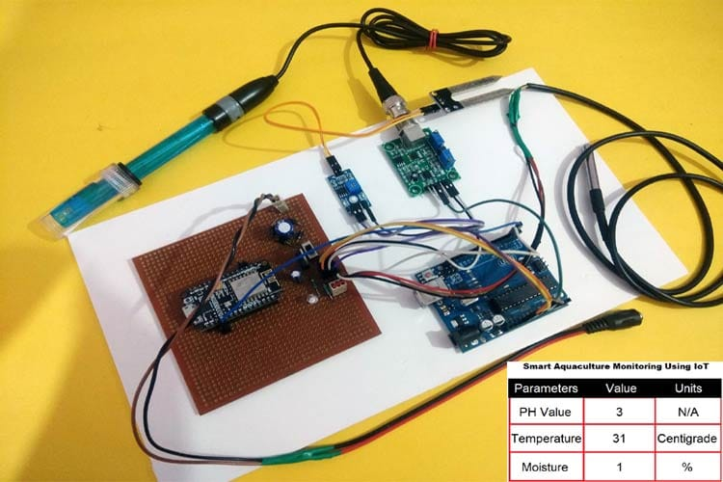
smart water quality monitoring system using Arduino project
Agriculture is the backbone of our country and it is very important to know the parameter of soil and water for efficient harvesting. The various parameters that can be monitored are Soil moisture, pH of water, Temperature, etc. We previously measured these parameters in different tutorials but today we will not only combining them but also display them on a webpage so that they can be monitored from anywhere in the world.So before starting with this smart water quality monitoring system using Arduino project

Slide 6
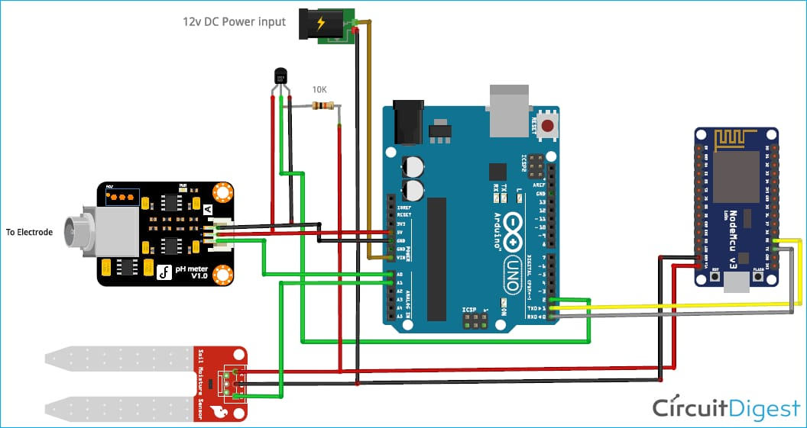
Circuit diagram
For this Arduino based Smart Water Quality Monitoring System is given below:

Slide 7
Technical Specifications:
Temperature range: -55 to 125°C
bit selectable
resolution: 9-12 bit
1-Wire interface
Unique 64-bit address enables multiplexing
Accuracy: ±0.5°C
Operating Voltage: 3-5 VDC
Conversion time: 750ms at 12-bit Pinout of DS18B20:
VCC: Power input: (3.3 – 5) V
DCGround: Ground pin of the circuitData: 1 Wire temperature value data output pi

Slide 8
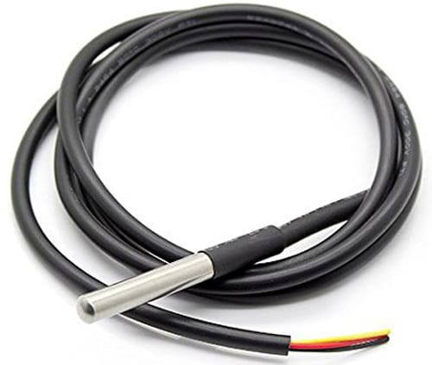
DS 18B20 wire
DS18B20 is a single wire temperature sensor, as this can be interfaced with microcontroller or Arduino using single data wire. This is available in a waterproof and Non-waterproof format.

Slide 9
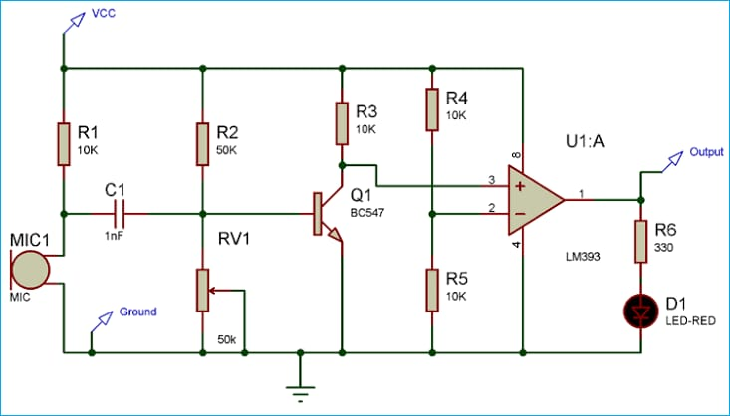
ARDUINO CONTROLLED MUSICAL WATER USING SOUND SENSOR
The basic idea of this Arduino Water Fountain is to take an input from any external sound source like mobile, iPod, PC etc., sample the sound and break it down to different voltage ranges, then use the output to turn on various Relay.

Slide 10
THE BLOCK DIAGRAM BELOW IS A GENERAL DESIGN OF OUR SOLUTION. WE DIVIDE OUR DESIGN INTO FOUR MODULES, INCLUDING POWER SUPPLY, CONTROL UNIT, EXTERNAL CONTROL, AND MECHANICAL UNIT
THIS BLOCK CONTAINS THE FOUR SENSORS. THE DATA ACQUIRED FROM THE SENSORS WILL BE TRANSMITTED TO THE CONTROL UNIT.
CONTROL UNIT WILL THEN HAVE SOME LOGIC DESIGNED TO SEND CORRESPONDING SIGNALS TO CONTROL OTHER BLOCKS OF THE WATER FOUNTAIN.
AT THE SAME TIME, THE DISPLAY SCREEN ON THE WATER FOUNTAIN WILL DISPLAY THE READINGS ALONG WITH THE DETERMINED WATER QUALITY LEVEL AND REMAINING WATER QUANTITY.
A WATER-PROOF TEMPERATURE SENSOR IS GOING TO BE USED. PART NUMBER FROM SPARKFUN IS: DS18B20 [6]. THIS TEMPERATURE SENSOR IS COMPATIBLE WITH A RELATIVELY WIDE RANGE OF POWER SUPPLY FROM 3.0V TO 5.5V.
THE MEASURED TEMPERATURE RANGES FROM -55 TO +125 CELSIUS DEGREES. BETWEEN -10 TO + 85 DEGREES, THE ACCURACY IS UP TO +-0.5 DEGREES. THIS SENSOR CAN FULFILL ALL REQUIREMENTS NEEDED FOR THIS PROJECT.

Slide 11
conclusion:
Traditional methods of conservation have been implemented to conserve water but smart devices that are leveraging IoT technology is the answer to taking water conservation to a new level.

